Slide 1

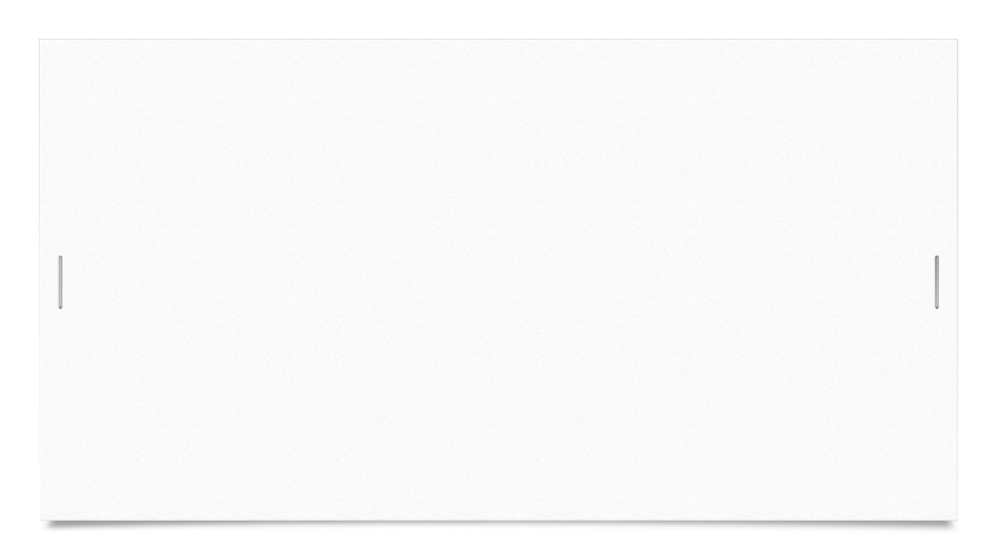


Taha Mohamed Alzain Muhammad Nadeem Fadi Atia Dasus Oskars Arajs Alexandru Vieru
GROUP 4

Slide 2
Agenda
Introduction
Requirements
SCRUM
Class Diagram
Design Patterns
RMI
Testing

Slide 3
Introduction
The goal of this presentation is to explain how the client server system has been created and what tools where used for its realization.

Slide 4
Requirements
Functional requirements:
The system must allow the employees to list all members.
The system must allow employees to search for members that have not paid their membership fee.
Non functional requirements:
The system must provide a client server connection.
At least 4 java design patterns must be implemented.

Slide 5
SCRUM
Time Schedule
Burndown Chart

Slide 6
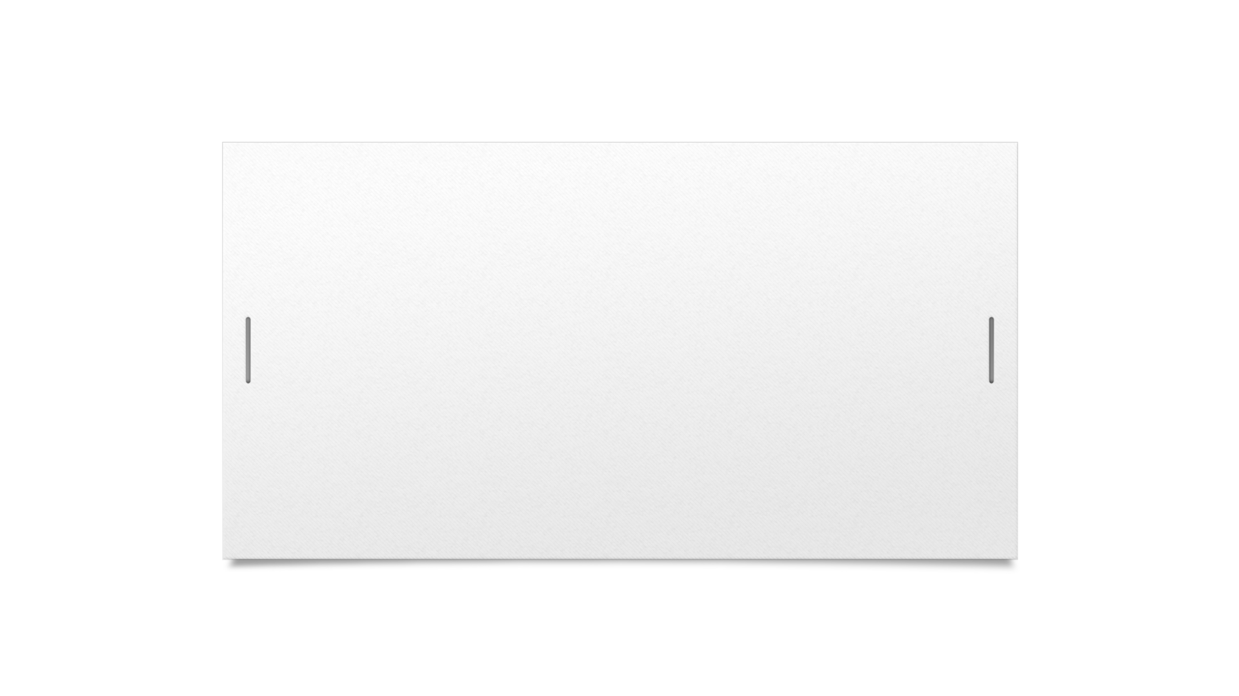
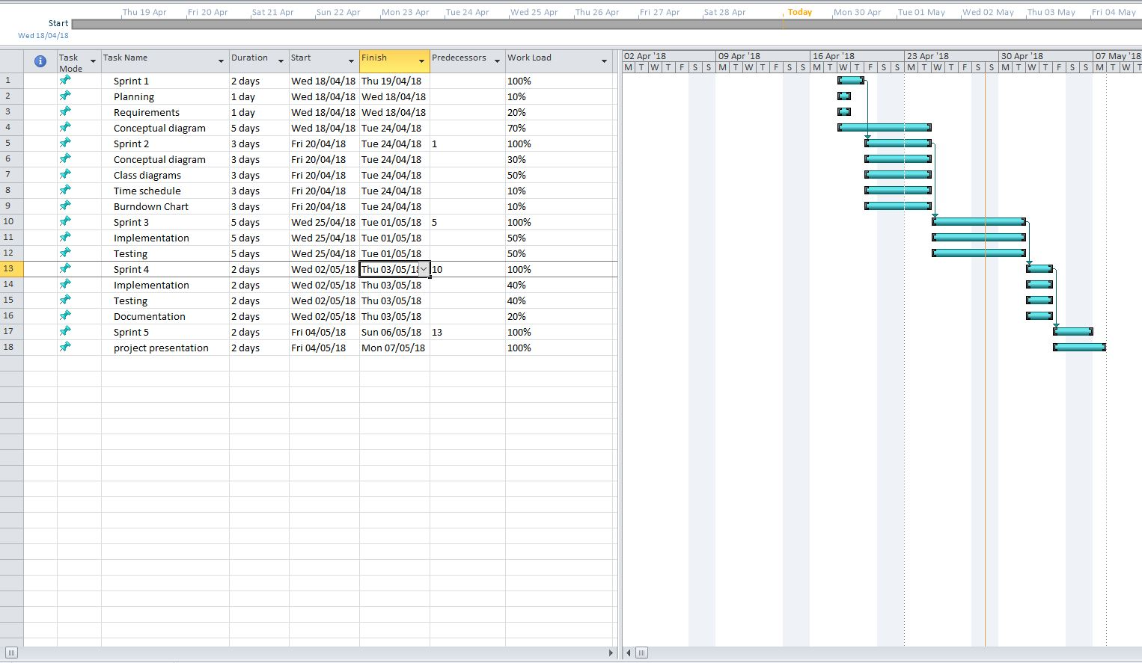

Time schedule

Slide 7
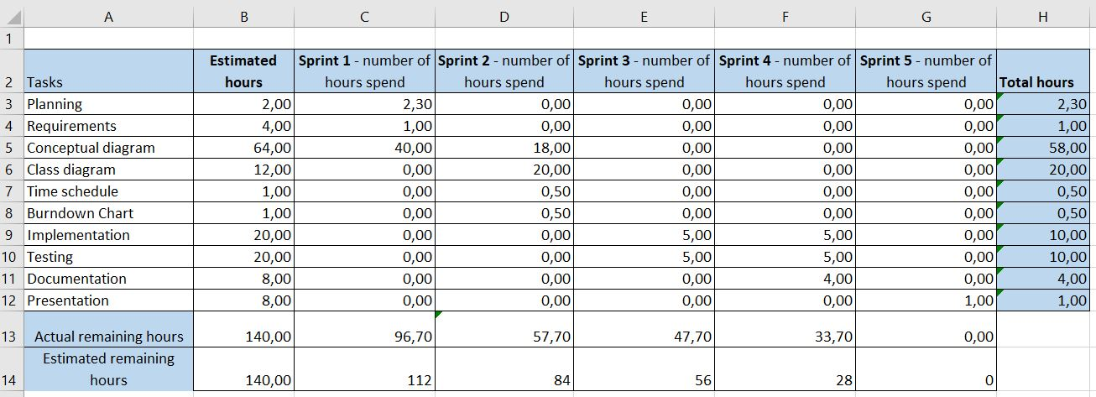
Burndown chart

Slide 8
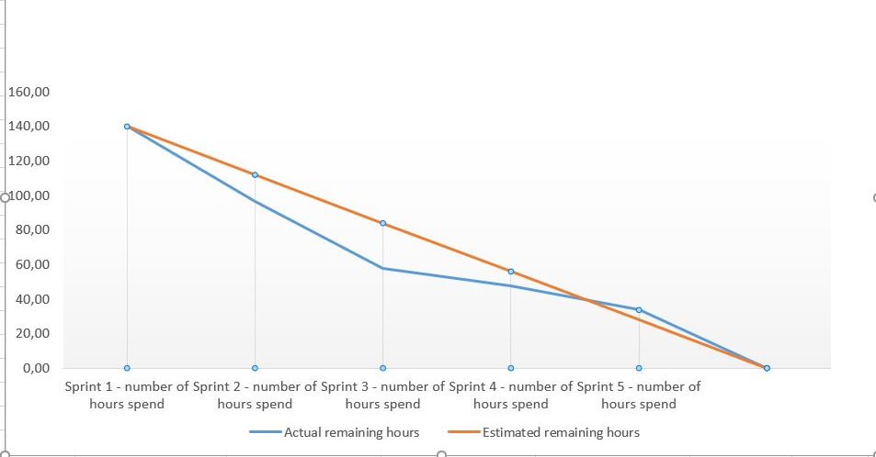

Slide 9
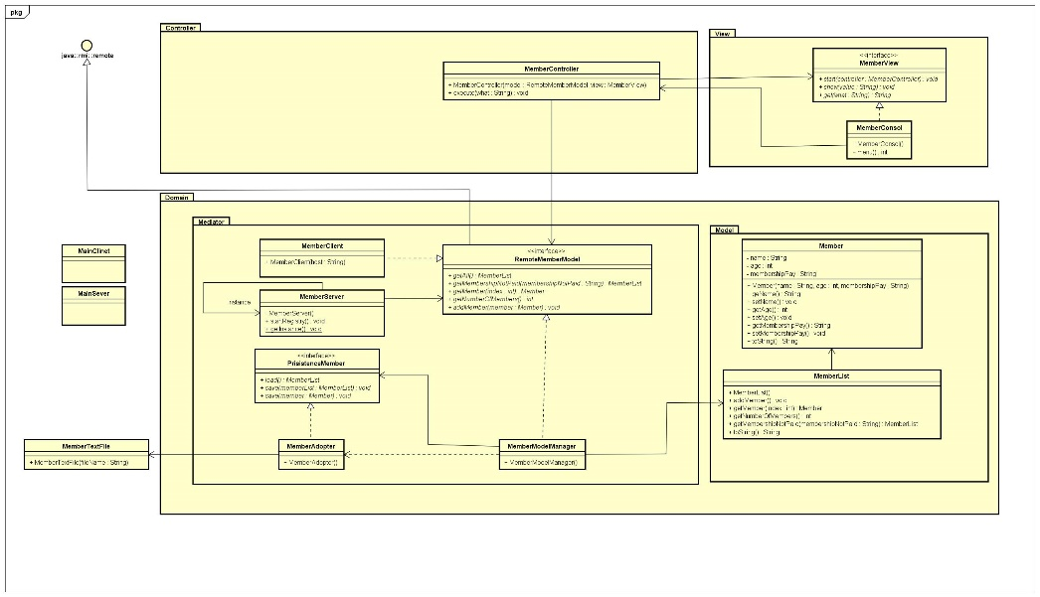
Class diagram

Slide 10
Design patterns
MVC
Singleton
Façade
Adapter

Slide 11
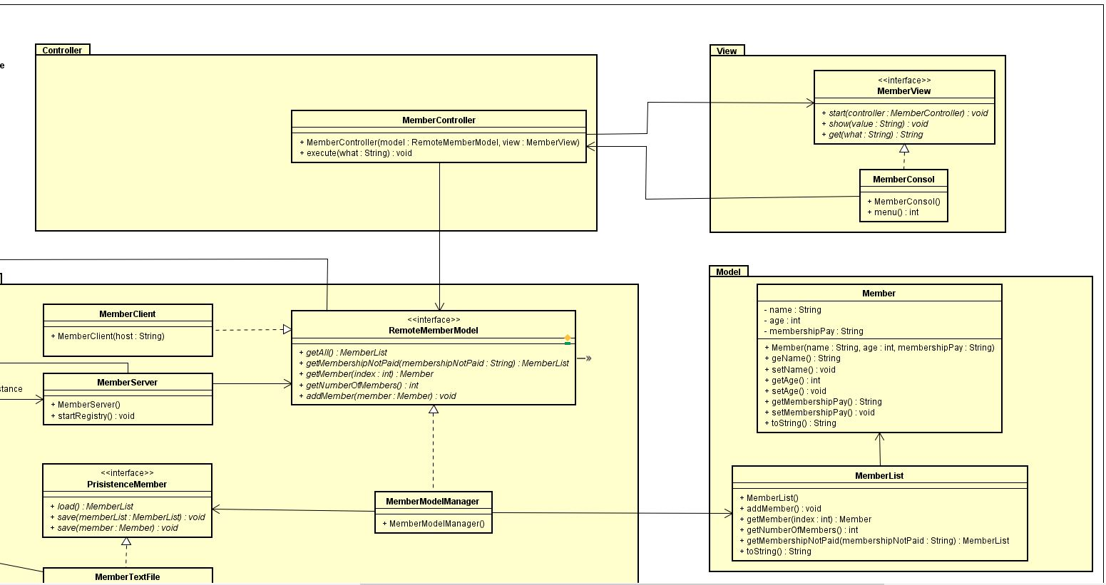
MVC

Slide 12
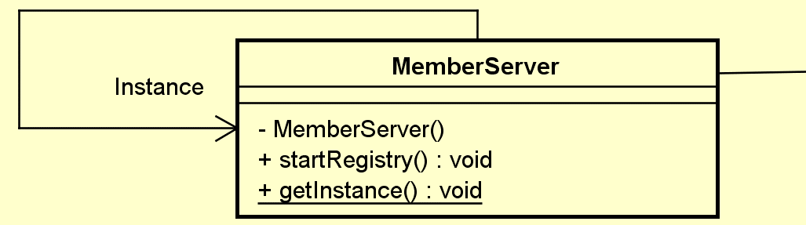
Singleton

Slide 13
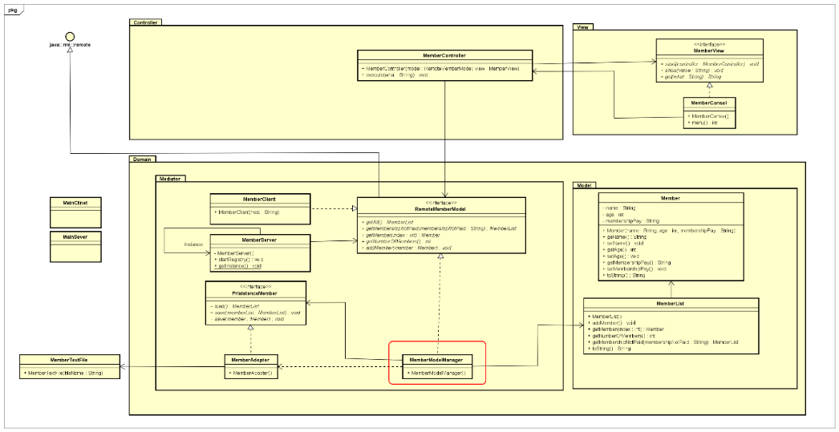
Facade

Slide 14
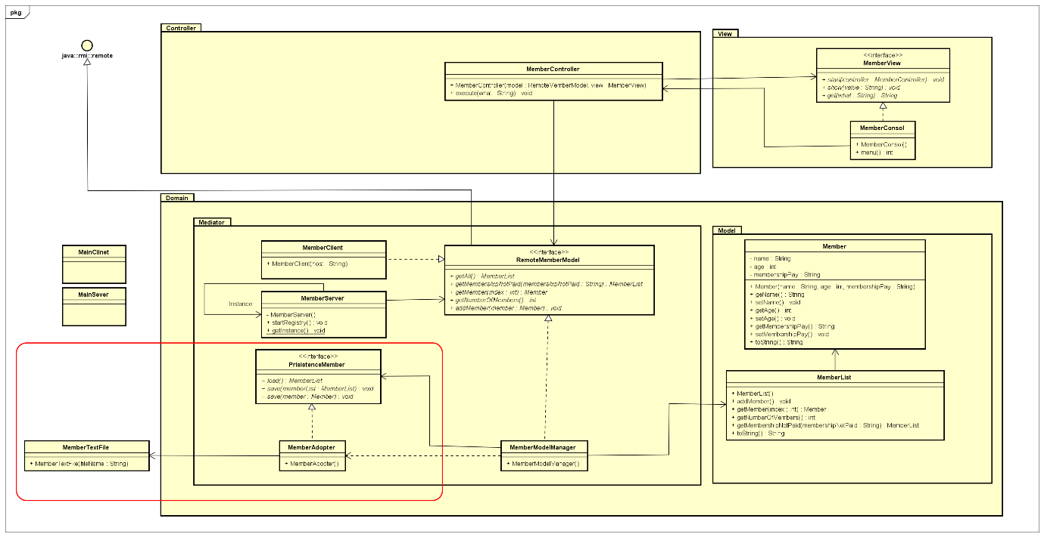
Adapter

Slide 15
RMI
RMI is used for communication among objects.
It also invoke methods from remote object.
MemberClient communicate with MemberServer

Slide 16
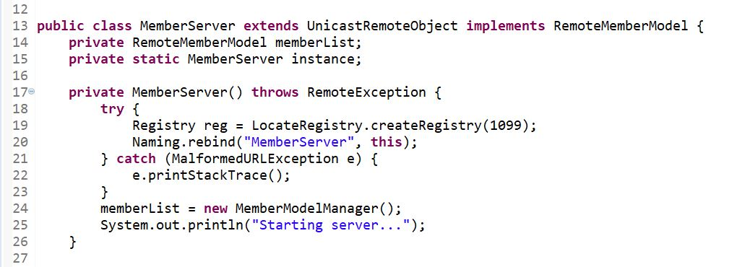

Slide 17
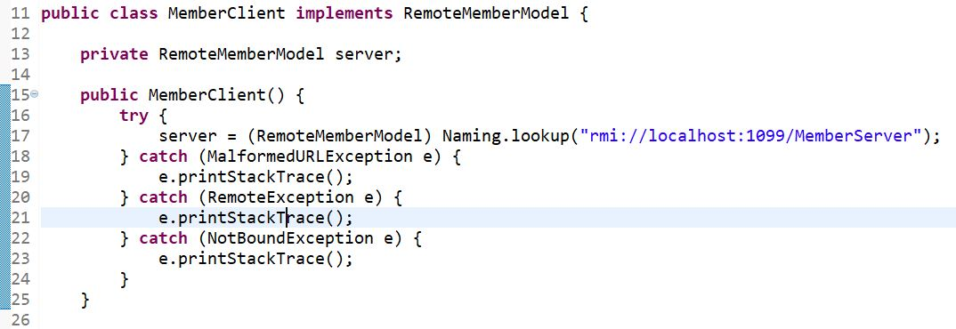

Slide 18
Testing
Testing is the documentation of the result to make sure it fulfils all the requirements.
To test the functionality we have tested each and every method in
Member, MemberList and MemberModelManager.
Members who did not paid membership fees.

Slide 19
